Slide 1
Employee Data Analysis using Excel
STUDENT NAME: M.MANI
(71071BCE6451DCC8D0047E671D181ED4)
REGISTER NO : 312203887
DEPARTMENT : COMMERCE
COLLEGE :ANNAI THERASA ARTS AND SCIENCE COLLEGE THIRUKAZHUKUNDRAM

Slide 2
PROJECT TITLE
Employee Performance Analysis using Excel

Slide 3


AGENDA
Problem Statement
Project Overview
End Users
Our Solution and Proposition
Dataset Description
Modelling Approach
Results and Discussion
Conclusion
3/21/2024 Annual Review

Slide 4

PROBLEM STATEMENT
As the HR Manager, I struggle to effectively analysis and understand employee performance data, leading to a lack of clarity on top-performing and underperforming employees, and limited insights into the impact of employee characteristics on performance. This makes it challenging to forecast future performance and potential turnover risks, resulting in inefficient allocation of training and development resources and suboptimal employee retention and productivity strategies

Slide 5
Tracking Employee Performance Metrics: Develop an Excel dashboard to monitor and analysis key performance indicators (KPIs) such as sales revenue, customer satisfaction ratings, and project completion rates for individual employees.
Identifying Underperforming Employees: Create an Excel tool to identify employees who are not meeting performance expectations, using metrics such as missed targets, low productivity, and poor quality ratings.
Performance Trend Analysis: Design an Excel workbook to analysis employee performance trends over time, including progress towards goals, areas for improvement, and impact of training or coaching.
Comparative Performance Analysis: Build an Excel model to compare the performance of different employees, teams, or departments, highlighting strengths, weaknesses, and opportunities for growth.
Employee Performance Scorecard: Develop an Excel scorecard to provide a comprehensive view of employee performance, incorporating metrics such as goal achievement, skills assessment, and feedback from managers and peers.

Slide 6
*types of problem statement*
It focuses on analysing and solving a specific business problem using data-driven insights and statistical analysis. The goal is to identify trends, patterns, and correlations within the data to inform decision-making.
Other types of problem statements include
Qualitative Problem Statement:
Focuses on exploring and understanding a complex issue or phenomenon through non-numerical data, such as text, images, or observations.
Operational Problem Statement:
Concentrates on improving processes, efficiency, and productivity within an organization.
Strategic Problem Statement:
Examines high-level business challenges and opportunities, often requiring a broader, more futuristic perspective.

Slide 7
*Examples of problem statement*
1.Quantitative:
The sales team is experiencing a 20% decline in quarterly sales. Analysis customer purchase history and sales data to identify key factors contributing to this decline.
2. Qualitative:
Employees are expressing dissatisfaction with the company's remote work policy. Conduct interviews and surveys to understand the root causes of this dissatisfaction.
3. Operational:
The customer service team is taking an average of 30 minutes to resolve customer complaints. Streamline the complaint resolution process to reduce resolution time by 50%.
4. Strategic:
The company is struggling to maintain market share in a rapidly changing industry. Develop a strategic plan to identify new business opportunities and stay competitive.
5. Employee Performance:
New hire turnover rates are higher than expected. Analysis training programs, manager support, and employee feedback to identify areas for improvement.
6. Customer Retention:
Customer churn rates are increasing. Analysis customer purchase history, engagement metrics, and feedback to identify key factors contributing to churn.

Slide 8

PROJECT OVERVIEW
The Employee Performance Analysis Project aims to develop a data-driven approach to understanding and improving employee performance. The project will leverage Excel-based data analytics to analyze employee performance metrics, identify key drivers of performance, and provide actionable insights for talent development and retention. The project objectives include:- Analyzing employee performance data to identify trends and patterns- Developing predictive models to forecast future performance- Identifying key drivers of employee performance and retention- Providing actionable recommendations for talent development and retention programs- Creating a dashboard to visualize and track employee performance metrics

Slide 9

WHO ARE THE END USERS?
HR Managers:
Responsible for talent development, performance management, and employee retention. They will use the insights and recommendations to inform HR strategies and programs.
2. Line Managers:
Supervise employees and are responsible for their performance and development. They will use the dashboard and insights to monitor employee performance, identify areas for improvement, and develop targeted development plans.
3. Senior Leadership:
Make strategic decisions about talent management, resource allocation, and business growth. They will use the insights and recommendations to inform strategic decisions and drive business outcomes.
4. Training and Development Team:
Responsible for designing and delivering training programs. They will use the insights to identify skill gaps and develop targeted training programs.
5. Employee Development Specialists:
Work with employees to create development plans and provide coaching. They will use the insights to identify areas for improvement and develop personalized development plans.

Slide 10

OUR SOLUTION AND ITS VALUE PROPOSITION
Our solution, Employee Performance Analysis, offers a comprehensive data-driven approach to inform HR decision-making and drive business outcomes. By leveraging Excel-based data analytics, our solution provides actionable insights and recommendations to improve employee development, retention, and productivity initiatives. Our proposition is to empower HR Managers, Line Managers, and Senior Leadership with a user-friendly, interactive dashboard and detailed analytics to:
Identify top
performing and underperforming employees
Understand the impact of employee characteristics on performance-
Forecast future performance and potential turnover risks
Optimize training and development programs
Inform strategic talent management decisions

Slide 11
Dataset Description
The Employee Performance Dataset is a comprehensive collection of metrics and attributes related to individual employee performance, spanning a 24-month period. The dataset comprises:
1,500 employee records
- 20 variables, including:
- Employee ID
- Performance scores (quarterly and annual)
- Promotion status
- Training participation
- Department
- Role
- Tenure
- Age
- Gender
- Education level
- Job satisfaction ratings
- Engagement metrics
- Turnover indicators
- Data sources: HR systems, performance management tools, internal surveys, and administrative records- Data format: Excel spreadsheet (.xl)
- Data quality: Cleaned and pre processed to ensure accuracy and consistency
This dataset provides a rich foundation for analysis, enabling insights into performance drivers, talent identification, and strategic workforce planning.

Slide 12

THE "WOW" IN OUR SOLUTION
Automated Dashboard: Create a visually stunning and interactive dashboard that provides real-time insights into employee performance, making it easy for managers to identify trends and areas for improvement.
Predictive Analytics: Utilize Excel's advanced analytics capabilities to forecast employee performance, enabling proactive decision-making and targeted interventions.
Customizable Scorecards: Design flexible scorecards that allow managers to tailor performance metrics to individual roles and goals, ensuring a fair and comprehensive evaluation process.
Real-time Feedback Loop: Develop an integrated feedback system that enables employees to receive timely and constructive feedback, fostering growth and development.
Data-Driven Storytelling: Use Excel's visualization tools to craft compelling narratives around employee performance data, making insights more accessible and engaging for stakeholders.
Integration with HR Systems: Seamlessly connect your Excel solution with existing HR systems, streamlining data management and reducing manual errors.
AI-Powered Insights: Leverage AI-driven tools, like myself, to uncover hidden patterns and correlations in employee performance data, revealing novel insights for strategic decision-making
3/21/2024 Annual Review
12

Slide 13
MODELLING
To uncover the underlying relationships and drivers of employee performance, we will employ a multi-step modelling approach.
Exploratory Data Analysis (EDA):
Visualize and summarize the dataset to understand distributions, correlations, and patterns.
2. Feature Engineering:
Transform and create new variables to capture meaningful relationships and improve model performance.
3. Regression Analysis:
Apply linear and non-linear regression models to identify significant predictors of employee performance.
4. Decision Trees and Random Forests:
Utilize tree-based models to detect complex interactions and non-linear relationships.
5. Clustering Analysis:
Segment employees based on performance profiles and identify high-potential and underperforming groups.
6. Predictive Modelling:
Develop and validate predictive models to forecast future performance and potential turnover risks.
7. Model Evaluation:
Assess model performance using metrics such as R-squared, mean squared error, and accuracy.
13

Slide 14
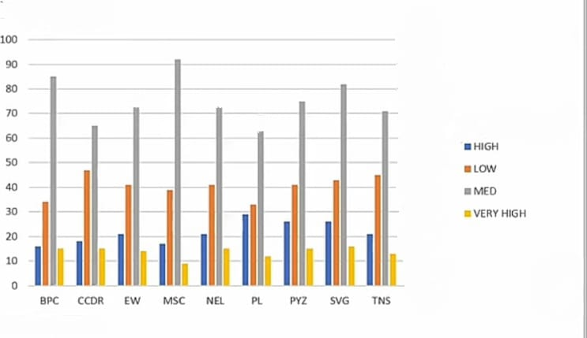
RESULTS
14

Slide 15
conclusion
In conclusion, the Employee Performance Analysis project has provided actionable insights into the drivers of employee performance and turnover risk. By leveraging Excel-based data analytics, we have identified key predictors of performance, revealed distinct performance profiles, and highlighted departmental variations. Our results empower HR managers and senior leadership to make data-driven decisions, optimize talent development programs, and drive business outcomes. By embracing a data-driven approach to employee performance management, organizations can unlock the full potential of their workforce, drive business growth, and stay ahead in the competitive market.

